Slide 1


SAP UI5 & FIORI with OData TRAINING
Anubhav Oberoy
Day – 19

Slide 2

Agenda – Day 19
Integrating with Odata Entities
Getting the Association in UI
Implementing Create in the UI
Implementing Upadte in UI
Implementing Delete uisng UI
Calling Function Import form the UI
Introduction to GitHub
Creating a Git Repository in GitHub.

Slide 3

Exercise: Fiori Integration
In this exercise we will add the configuration to Integrate the OData with our existing app.
And we will bind the View1 with the OData model.
Along with that we will also see how to read the data of a single product.
To do that when we select a product form the product list then the details of that product will be loaded on the View2.
Exercise part 1 code/resource: Configuring the app to access OData and loading the list of products on view1
manifest.json
ui5.yaml
package.json
View1.view.xml
ui5.yaml and ui5-local.yaml config for VS Code
ui5.yaml
ui5-local.yaml
Exercise part 2 code/resource: Getting the data of single product with association To_Supplier on View2.
View1.view.xml
View1.controller.js
View2.view.xml
View2.controller.js
MoreInfo.fragment.xml

Slide 4
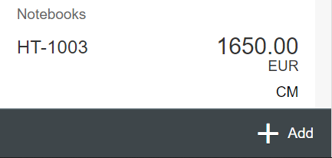
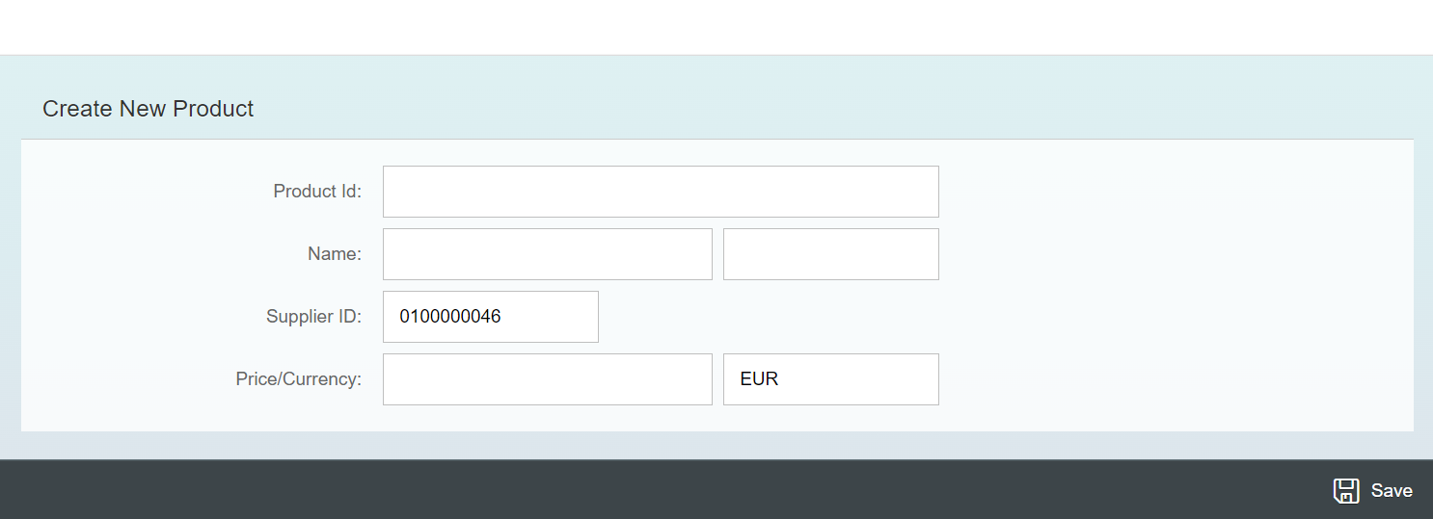
Exercise - Implement Create using UI
Now we will implement create operation in the UI. To do that we need to add a new screen in our application. In that screen we will add a simple form to fill the details of the product and a Save button in the footer of that page.
For this have to a new Add button in the footer of the View1 and on press of that button we will navigate to the new Add View.
Exercise code/resource:
View1.view.xml
View1.controller.js
Add.view.xml
Add.controller.js
manifest.json

Slide 5

Exercise – Implementing Update and Delete
Now we want to Update and Delete the selected record form the backend. To do that we will load the data of the record. Once the data is loaded to update and delete the data, we will add two buttons in the footer of the view named as Save and Delete. We will also add a clear button to clear the data of form.
On entering the Product ID of the product in the Input field and press enter we will load the data of that product in the Form.
Exercise code/resource:
Add.view.xml
Add.controller.js

Slide 6
Exercise – Using Function Import from UI
Now we want to Call the function import form the UI. To do that we will add a button near the Product Id input field. On press of that button, we will load the most expensive product in the form.
Exercise code/resource:
Add.view.xml
Add.controller.js

Slide 7

Introduction to Git and GitHub
Git is a version control system that lets you manage and keep track of your source code history.
GitHub is a cloud-based hosting service that lets you manage Git repositories.
Git HUB is a central repository to store all the code. Git is a distributed repository management system, which allows development teams to organize and sync their development code.
Use Case- I am working as a Fiori Developer in an MNC and I want to share my code with fellow developers, currently I am downloading the zip/tar file and sharing over email.
This way we will have piles of emails in our account,
especially when we work in a team of size 40 developers it becomes very hard to sync changes.
There is version control. Last night my app was stable, I made some changes this morning which messed up the whole project. I some how pray to god that can you please take me in past.
In a big team, many developers touching each other’s code and it’s hard to blame someone who disrupt the code.
It is also very hard to merge changes when done in same file.
As a developer, I am using BAS today, tomorrow I will use VS Code and next day Web IDE and very next week Atom. How can I easily port my code between these tools.
You can install git in local machine using below link (however, it comes along with all dev tools)
https://git-scm.com/downloads

Slide 8


How GitHub Works and commands in Git
We will see some important commands related to Git and will see how GitHub works.
Some important commands to use git.
git Init: It is used to initialize a new Git Repository in the system.
git add <filename>: It is used to stage the changes of the file to git repository. We can use ‘git add .’ to stage the changes of all files.
git commit: It is used to commit all the staged changes with a message.
git reset hard: Discard all the staged changes and discard the changes in all the files.
git push: It is used to push all the changes in the git repository.
git pull: It is used to pull the new changes made by other users in the project.
git status: It is used to check the status
git clone: It is used to clone a repository.
git remote add <repo URL>: Add a local repository to a remote repository.
Fiori Project (or any kind of project)
User (Anubhav)
But how all users will work on the project at a same time?
Anubhav’s local machine
Here GitHub comes into picture
Users which are working on the different parts of the same project on different Platforms (BAS, VS Code, Web IDE)
Project Repository
The project will be kept in a repository in the GitHub

Slide 9
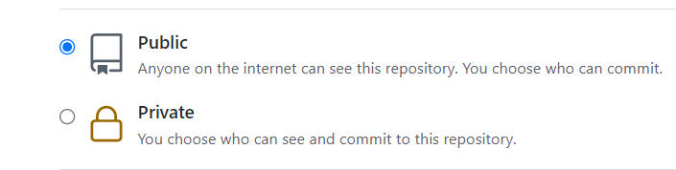
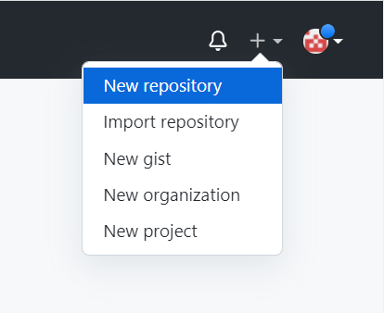
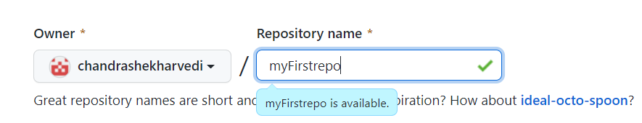
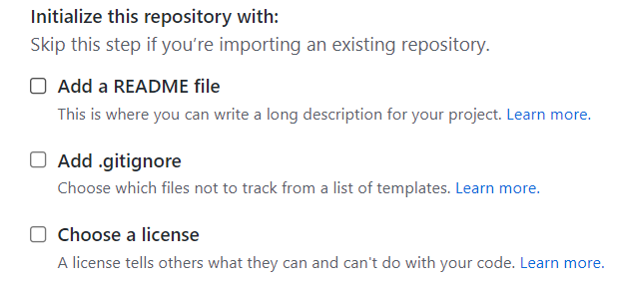
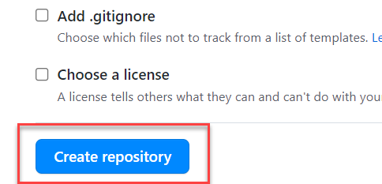
Steps to Create a new git Repository
Step by Step process to create a git repository in GitHub. First of all you must have a GitHub account, if not then go to this link https://github.com/signup?source=login and create a new Account.
Step 1: Click on the plus button in the top right corner of the screen and select ‘New Repository’.
Step 2: Type a short, memorable name for your repository. And give a description (optional).
Step 3: Select the type of repository. Public or Private
Step 4: Set how you want to Initialize the repository.
Step 5: Click on Create Repository. Your Repository will be created.
Repository Created Successfully

Slide 10


Adding project to git repository
Project on Local System
1
git init
Initialize a git repo
2
git add .
Stage all the changes
3
git commit –m “message”
git pull
Once the project is connected to git repo then we just use the git pull and git push commands to get the new changes and send our changes
Stage all the changes
git push
5
git add remote <repo URL>
Add the remote branch
GitHub Repository
git push
5
Clone repository for the first time in system
git clone <repo URL>
GitHub Repository

Slide 11
Jack
Romi
VS Code
BAS
commit
push
Github
project

Slide 12

End of Day 19

Slide 13

Questions

Slide 14

Anubhav Oberoy

Slide 15


We’re committed to empower you to be
Most Desirable Resource
through powerful training solutions.
We build the workforce of the future.
250+
Corporate Clients
30,000+
Learners Trained
25000+
Learners Placed
FREE WEBINARS
Sign up for free webinars with industry experts every fortnight!
Enroll Now!
Contact us today!
https://anubhavtrainings.com/

Slide 16




More from AnubhavTrainings.com

Slide 17
Title
Content

